Slide 1
State supporting science and technology challenge.
Measures for modern scientific landscape.
By Lyudmila Ogorodova
Deputy Minister, Ministry of Education and Science of the Russian Federation
3rd March 2014

Slide 2
The state measures for development of science and technology to 2020:priorities
Nanosystems, Industry
Information and telecommunication systems
Life sciences (incl. Health research and Biotechnology)
Energy Effectiveness, Energy Saving, Nuclear Energy
Rational Nature Exploitation
Transport and Space System
Network of centres of collective usage of scientific equipment
Mega-science research infrastructure
Mega-grants (Decree №220 «On the measures aimed to attract leading scientists to the Russian establishments of higher professional education, scientific institutions of the state science academies and state research centers of the Russian Federation»)
Programmes for leading universities “5 to top 100”

Slide 3
The mechanisms of state support of science and technology in the Russian Ministry of Education and Science
The Federal Targeting Program (FTP) «Research and development of the priority areas of the scientific and technological complex in Russia» in 2014-2020
The FTP «Development of pharmaceutical and medical industry of the Russian Federation until 2020 and beyond»
The Government Regulation № 218 of 9 April 2012 «On the measures of state support of cooperation between the “Russian higher education institutions and organisations»
The Government Regulation № 219 of 9 April 2012 «Support of the development of innovative infrastructure in educational institutions»
The Government Regulation № 220 of 9 April 2012 «On the measures aimed to attract leading scientists to the Russian establishments of higher professional education, scientific institutions of the state science academies and state research centers of the Russian Federation»
Federal Statute №291-FS of 2 November 2013 «On the Russian Science Fund and amendments to certain legislative acts of the Russian Federation»

Slide 4
The FTP «Research and development of the priority areas of the scientific and technological complex in Russia» in 2014-2020
Overall objective: To support the development of a competitive and effective sector of applied scientific innovations.
Conduction of the applied scientific researches
~400 projects up to $0.6 million a year/ up to 3 years
Objectives:
To support the development of advanced scientific and technological innovations of an inter-disciplinary character in the priority areas.
To support the planning and co-ordination of research and product development.
To ensure the integration of the Russian sector of applied scientific innovation into the global environment including BRICS cooperation.
To ensure higher productivity of the Russian sector of applied scientific innovation.
Conduction of the applied scientific researches for certain economy sectors
~500 projects up to $0.9 million a year/up to 3 years
Conduction of the complex scientific researches
~30 projects up to $3 million a year
Conduction of the researches within international scientific and technological cooperation
~130 projects up to $1.5million a year/up to 3 years
Support and development of unique scientific installations
~15 projects up to $1.5 million a year/up to 3 yrs
Support and development of centers of collective use of scientific equipment
~40 projects up to $3 million a year/up to 3 years

Slide 5
Implementation of international coordinated calls in the priority areas by the Ministry of Education and Science of the Russian Federation in 2007-2013
Distribution of S&T projects by international partners within FTP on R&D (2007-2013)
Distribution of S&T projects by allocated funding within FTP on R&D (2007-2013)
Distribution of S&T projects by the targeted priority areas within FTP on R&D (2007-2013)

Slide 6
Awardees of Russian Mega-grants
(Decree No.220 “On the Measures Aimed to Attract Leading Scientists to the Russian Establishments of Higher Professional Education, Scientific Institutions of the State Science Academies and State Research Centers of the Russian Federation”)
1st call (2010): 39 grant contracts were signed. Among the grantees 21 are Russian (including 11 with double residence), 12 EU citizens, 3 winners from USA and 3 from other countries.
2nd call (2011): 38 grant contracts were signed. Among the grantees 18 are Russian (including 12 double citizenships), 12 EU citizens, 7 winners from USA and 1 from Japan.
3rd call (2012): 41 grant contracts were signed. Among the grantees 19 are Russian (including 9 double citizenships), 9 EU citizens, 5 winners from USA and 8 from other countries.
4th call (2013): 42 grant contracts were signed. Among the grantees 19 are Russian (including 11 double citizenships), 19 EU citizens, 2 winners from USA and 1 from Japan.

Slide 7
Russia’s involvement in the development of Mega-Science research infrastructure
Mega-Science research infrastructure
Development of advanced research infrastructure in the Russian Federation
• Tokamak "Ignitor “
• High flux research reactor, PIK complex
• Special Synchrotron Radiation Source of the 4th generation, SSRS-4
• Complex of Superconducting Rings for Heavy Ion Colliding Beams, NICA complex
• eXawatt Center for Extreme Light Studies (XCELS)
• Electron-Positron Collider (Super-Tau- Charm Factory)
• The European X-ray Free Electron Laser (XFEL)
• European Organization for Nuclear Research (CERN)
• Facility for Antiproton and Ion Research (FAIR)
• International Thermonuclear Experimental Reactor (ITER)

Slide 8
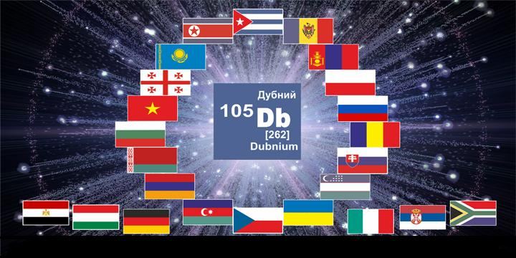
WHAT NEXT

